Slide 1
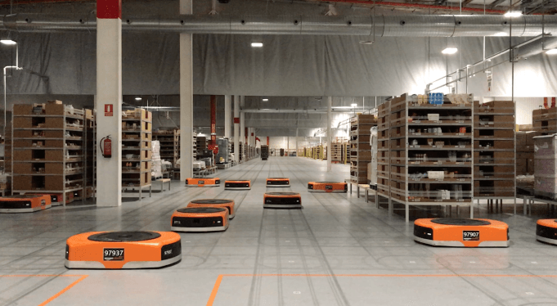
Amazon Robotics machines in a Amazon warehouse
Advancements with trajectory planning and path constraining
Luca Marseglia

Slide 2

Velocity law
When the angle between two subsequent rectilinear paths is too tight, the robot could steer with a high velocity that could be too high for such a steering angle.
For this reason, the velocity of the robot in each of the points of the path should be a function of this angle:
P3
P1
$$α$$
P2
2024 July | Slide 2

Slide 3
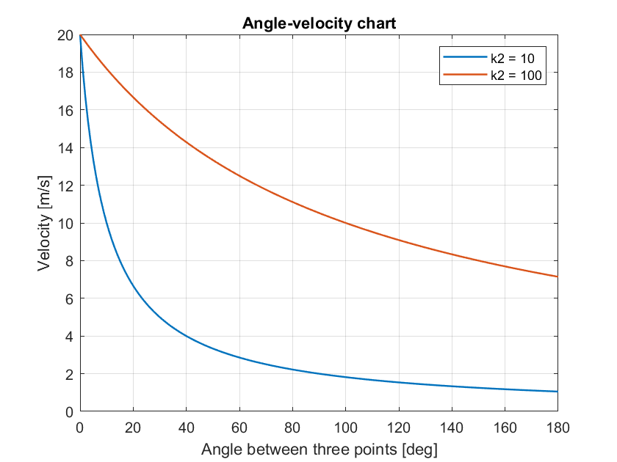
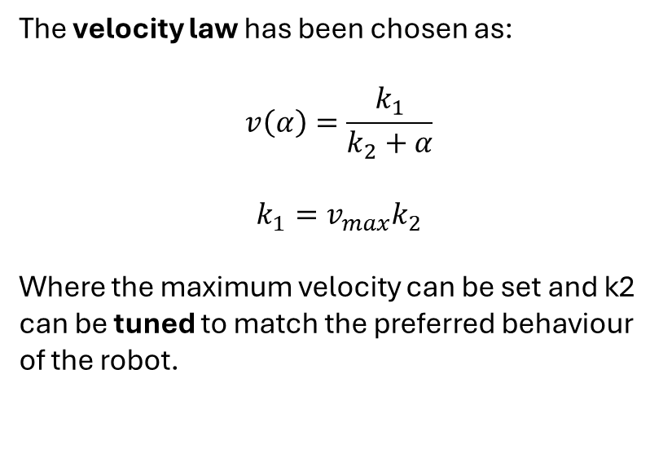
Velocity
The velocity law has been chosen as:
$$v\left(α\right)=\frac{k_{1}}{k_{2}+α}$$
$k_{1}=v_{max}k_{2}$
Where the maximum velocity can be set and k2 can be tuned to match the preferred behaviour of the robot.
2024 July | Slide 3

Slide 4
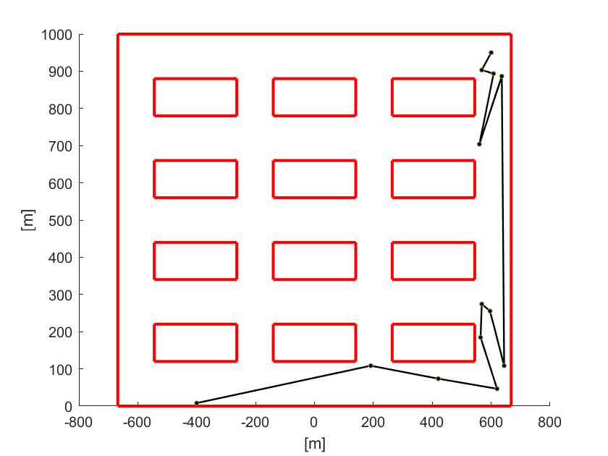
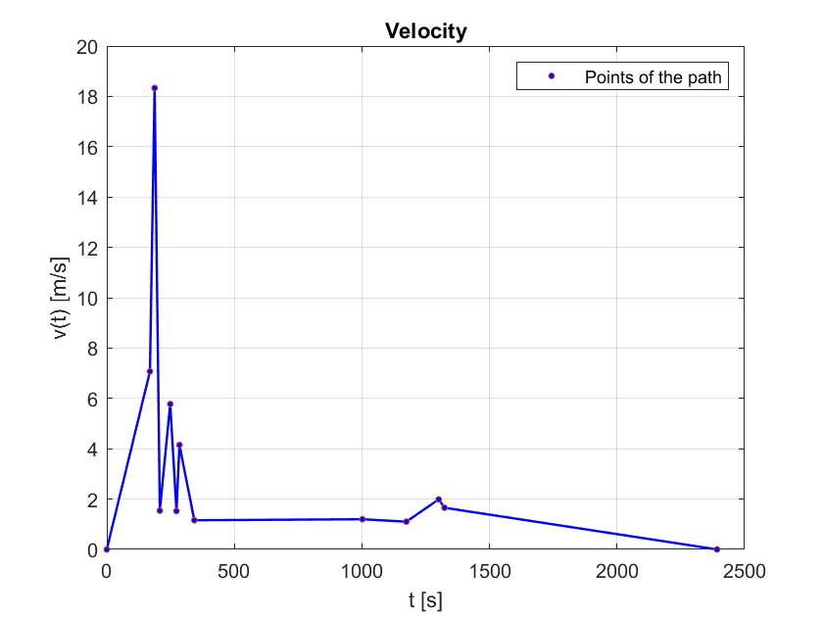
Velocity profile
The following plots show the behavior with the first velocity law:
2024 July | Slide 4

Slide 5
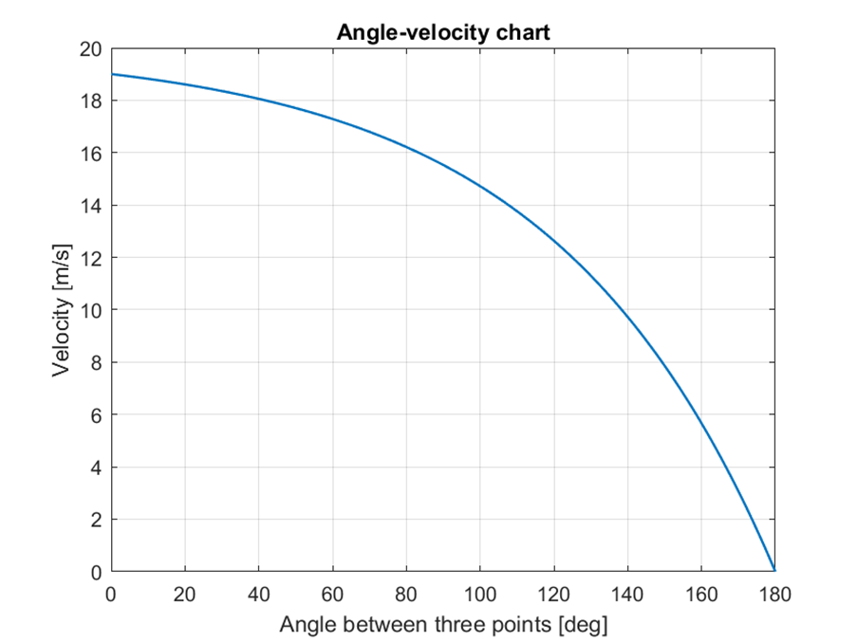
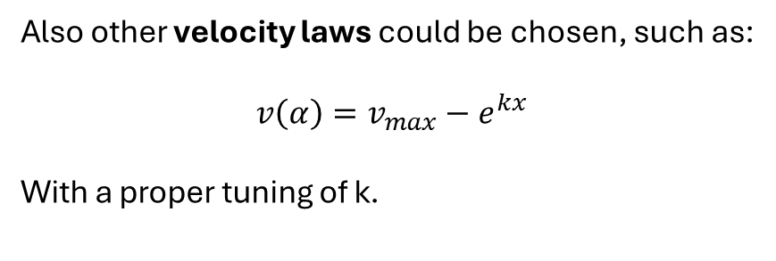
Velocity
Also other velocity laws could be chosen, such as:
$$v\left(α\right)=v_{max}−e^{kx}$$
With a proper tuning of k.
2024 July | Slide 5

Slide 6
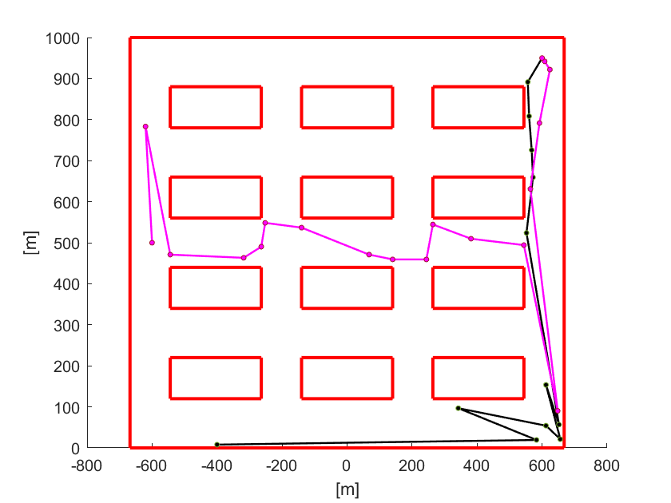
Two robots with the same goal
Suppose to have two robots, Robot 1 and Robot 2, with the same goal point and the same maximum speed of v = 20 m/s:
Robot 2
Robot 1
2024 July | Slide 6

Slide 7
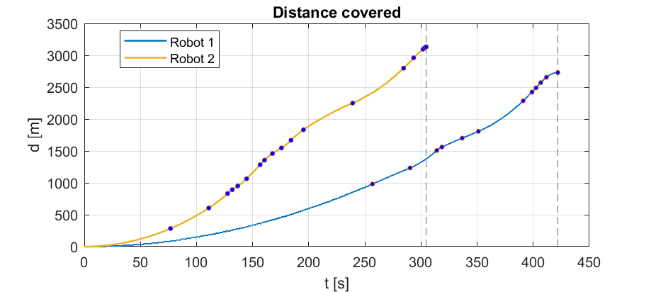
Two robots with the same goal
Robot 1 arrives to the goal at t = 421s, while Robot 2 arrives first at t = 304s:
2024 July | Slide 7

Slide 8
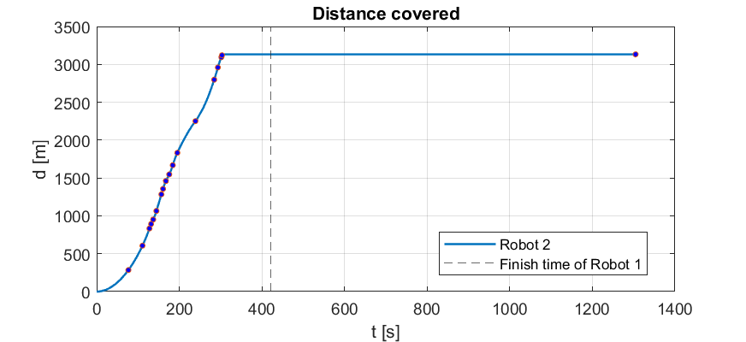
Two robots with the same goal
Once arrived, Robot 2 occupies the goal position for 1000 seconds, leaving it at t = 1304s.
Meanwhile, Robot 1 arrives at the goal position, but finds it occupied.
2024 July | Slide 8

Slide 9
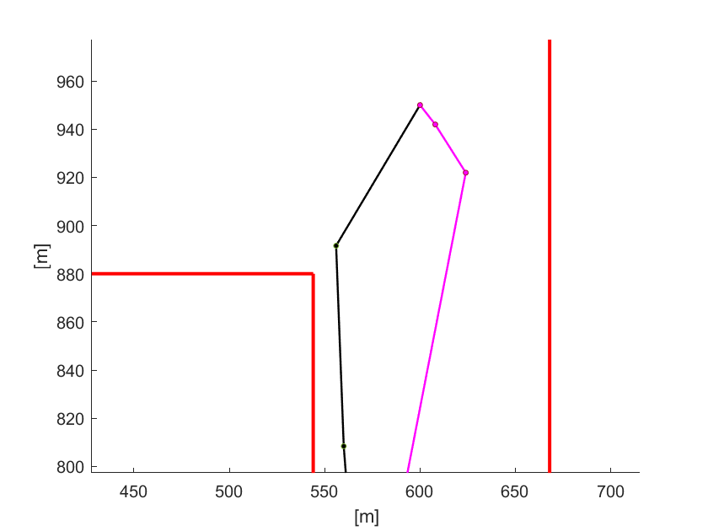
2 robots with the same goal
The algorithm makes Robot 1 wait until Robot 2 leaves the goal.
So Robot 1 waits in correspondence of the third-to-last point of its path, until Robot 2 leaves the goal point.
Robot 2
Goal point
Robot 1
2024 July | Slide 9

Slide 10
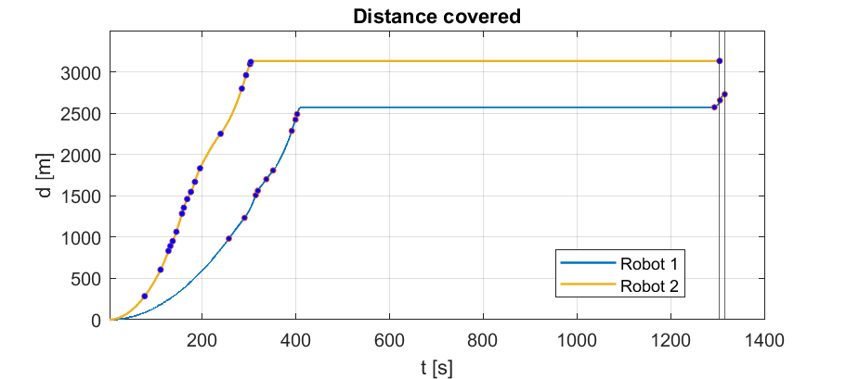
2 robots with the same goal
For this reason, before arriving to the goal, in correspondence of the third-to-last point of its path, Robot 1 waits for a dead time equal to:
t_dead = (Finish time of robot 2 + Goal dead time) – Finish time of robot 1
2024 July | Slide 10

Slide 11
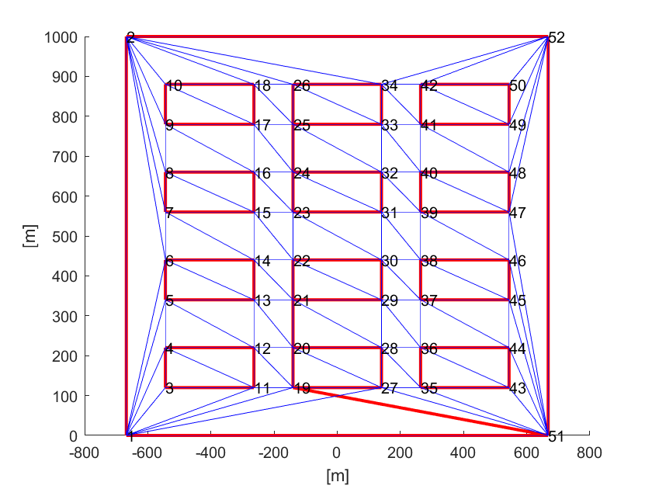
Constraining the path
Some more fake obstacles have been added to the path to constrain the path planning algorithm, but this process showed some problems with the triangulation:
2024 July | Slide 11

Slide 12
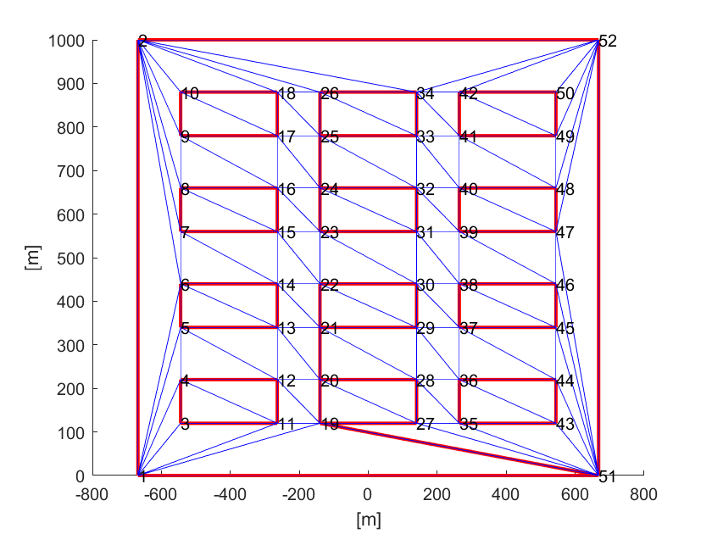
Constraining the path
A possible algorithm should automatically force the triangulation when adding new fake obstacles:
2024 July | Slide 12

Slide 13
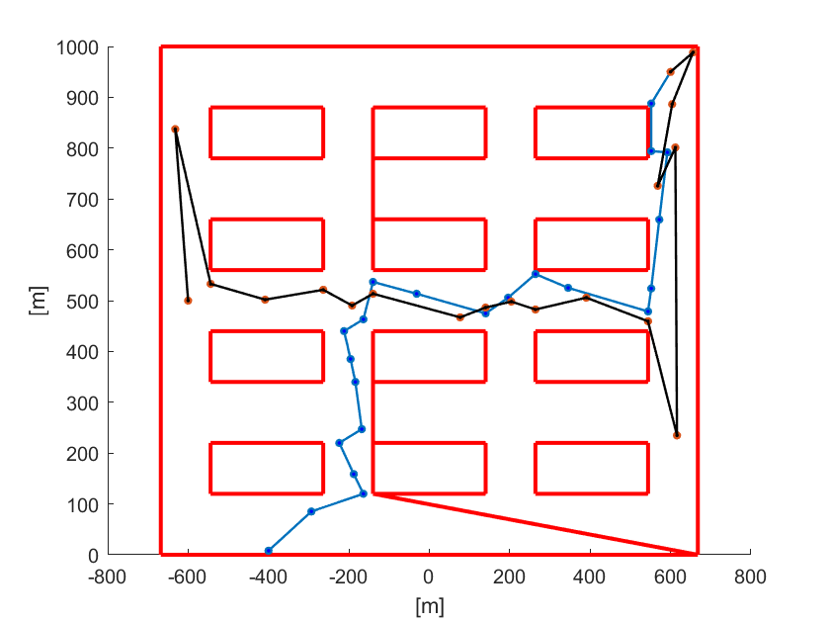
Constraining the path
For now, the obstacles have been added manually, and some initial results have been obtained:
2024 July | Slide 13

Slide 14
Future work
Given the shown algorithm for when a robot occupies the goal position, develop it to make it suitable for more than two robots
Develop an algorithm for automatically constraining the path of two robots by adding fake obstacles and browse papers on this topic
Monthly report?
2024 July | Slide 14

